Slide 1



Presented By
Abul Hasnat
Roll No. : 133102
Dept. of CSE
RUET
Supervised By
Sadia Zaman Mishu
Assistant Professor
Dept. of CSE
RUET

Slide 2
Outlines
Introduction
Motivation
Objectives
Background study
Proposed System
Conclusion
Future Works
References

Slide 3
Introduction
Imaging is the visual representation of an object’s form.
Spectral imaging is a branch of spectroscopy in which a complete spectrum or some spectral information is collected at every location on image plane and is processed.
The term Hyperspectral imaging comes under Spectral imaging.
Hyperspectral images are produced by instruments called Imaging spectrometers.
Spectral images are often represented as an image cube, a type of data cube.

Slide 4
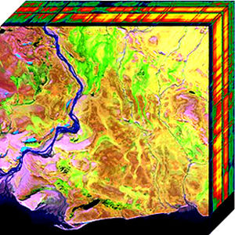
Figure : Two Dimensional Projection of Hyperspectral Cube

Slide 5
Introduction
Hyperspectral Images:
Hyperspectral imaging belongs to a class of techniques commonly referred to as spectral imaging or spectral analysis
Hyperspectral imaging is the collecting and processing of information from across the electromagnetic spectrum.
Human eye sees visible light in three bands, i.e. red, green, and blue whereas spectral imaging divides the spectrum into many more bands.

Slide 6
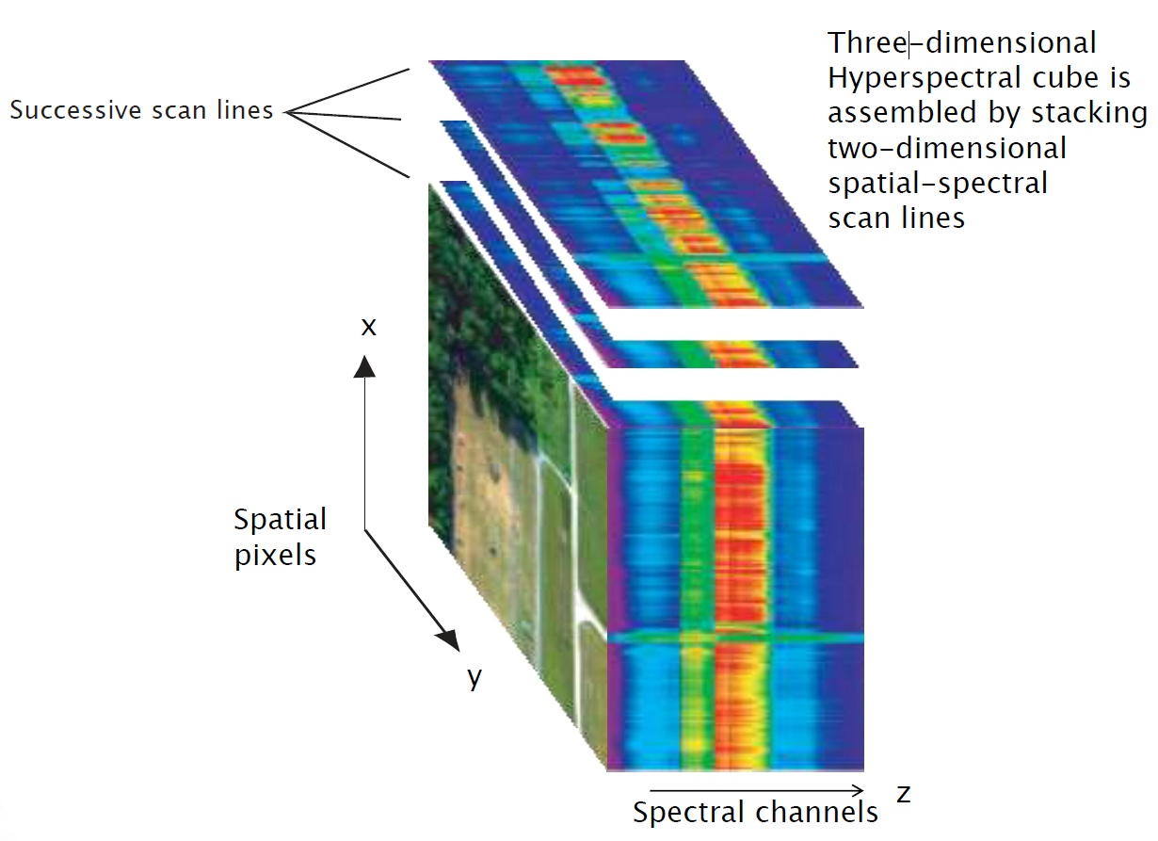

Slide 7
Motivation
  The goal of hyperspectral imaging is to obtain the spectrum for each pixel in the image of a scene, with the purpose of finding objects, identifying materials, or detecting processes.
  Hyperspectral sensors have been installed on aircrafts (HYDICE, AVIRIS), satellites (Hyperion), and have been started to be produced commercially (SOC 700) indicating large data availability in the near future.
  Engineers build hyperspectral sensors and processing systems for applications in astronomy, agriculture, biomedical imaging, geosciences, physics, and surveillance.

Slide 8
Objectives
Overcome Hughes Phenomenon problem
Extract only relevant features
Select most informative features

Slide 9
Background study
Hughes Phenomenon :
As the feature space dimension increases, if the size of the training data does not grow correspondingly, a reduction in the classiﬁcation accuracy of the testing data is observed due to poor parameter estimation of the supervised classiﬁer. This effect is known as the Hughes phenomenon [ 1, 2, 3 ].
One way to overcome this Hughes effect or also known as curse of dimensionality is feature reduction [4].

Slide 10
Proposed system
Collaboration of feature extraction and feature selection:
Feature extraction using Kernel Principal Component Analysis(KPCA)
Feature Selection Using Mutual Information(MI)

Slide 11
Remote sensing dataset
Dataset: AVIRIS 92AV3C
Spectral: 0.4 m-2.5 m
Spatial: 30m
Band: 220
Classes:16

Slide 12
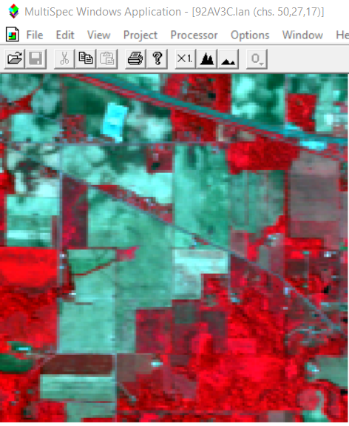
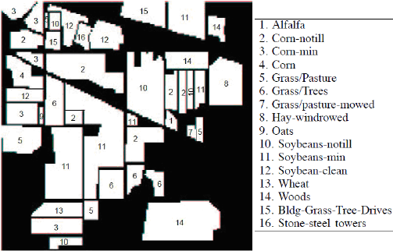
Remote sensing dataset
(a)
(b)
Figure: AVIRIS 92AV3C. (a) is original sensed data, (b) is ground truth map for the data

Slide 13
Feature extraction
A feature is a piece of information which is relevant for solving the computational task related to a certain application.
Feature extraction technique is a technique that-
Transformation of input data into a set of features.
Combining attributes into a new reduced set of features.

Slide 14
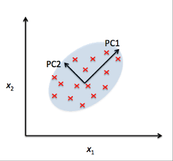
Feature extraction
Kernel Principal Component Analysis (KPCA) :
To understand KPCA, we have to understand the idea of PCA. The core idea of principal component analysis is transforming them into new set of orthogonal uncorrelated variables called Principal components(PCs).
Figure : Principal
Components

Slide 15
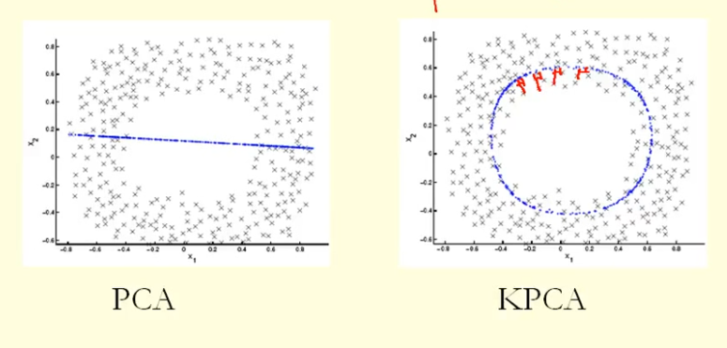
Feature extraction
Kernel Principal Component Analysis (KPCA) :
PCA works great in reducing the dimension of the dataset. But it finds the Eigen-vectors and covariance matrix on a linear basis. But in most of the practical datasets, data are mostly non-linear. Kernel PCA is a method that works great in dimensionality reduction when non-linear data is of concern.
Figure : PCA vs KPCA

Slide 16
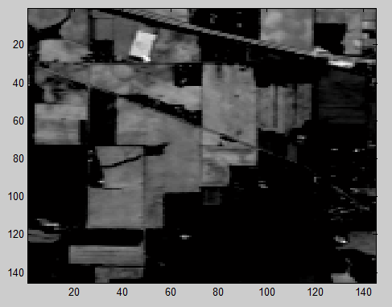
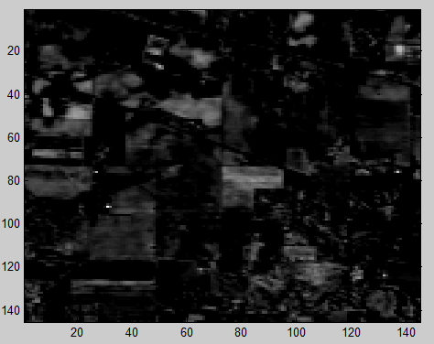
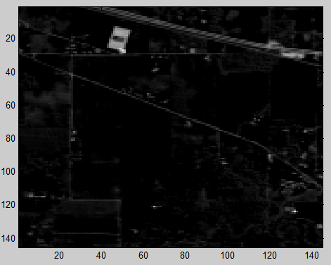
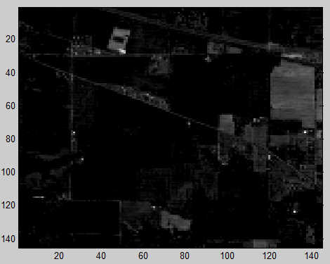
Results of PCA
PC1
PC2
PC3
PC4

Slide 17
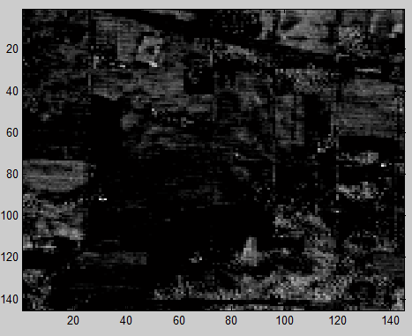
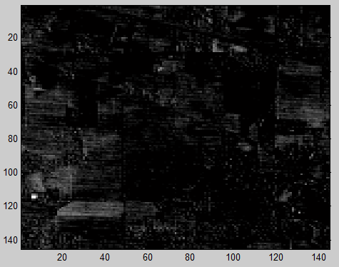
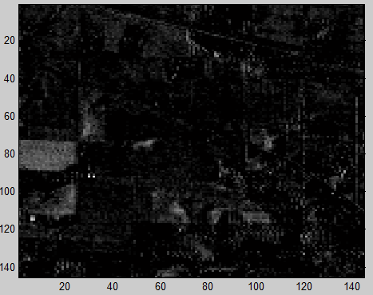
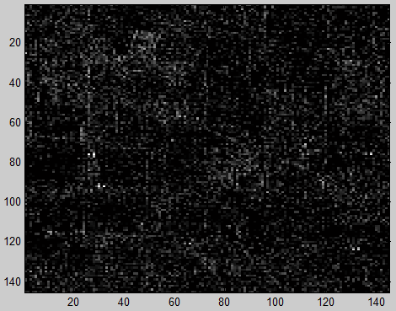
Results of PCA
PC5
PC6
PC9
PC10

Slide 18
Limitations of PCA
PCA does not consider the class separability ,since it does not take into account the class label when generating the eigenvectors.
Since PCA considers global statistics, there may be some classes which are small and hardly affect the overall statistics and hence are not represented in the ﬁrst few components

Slide 19
Feature selection
When the input data to an algorithm is too large to be processed and it is suspected to be redundant, then it can be transformed into a reduced set of features (also named a features vector). This process is called feature selection.
To overcome the limitations of PCA ,feature selection is done from the resulting principle components (PCs) using a mutual information (MI) measure.

Slide 20
Mutual information
Mutual Information is used to measure the similarities between two variables.
I(X,Y )=H(X) + H(Y) - H(X,Y) [5]
Here, H(X) and H(Y) are the entropies of X and Y, respectively, and H(X,Y) is their joint entropy.

Slide 21
Conclusion
As KPCA has slight advantage over the PCA while performing operations on non-linear data, it is expected to give better result. That is why I’ve chosen KPCA. Moreover, Support vector machine(SVM) classifier will be used during the implementation phase.

Slide 22
Future works
Feature extraction using Kernel PCA
Classification of hyper spectral image using Support Vector Machine (SVM)

Slide 23
Refferences
[1] G.F. Hughes, “On the mean accuracy of statistical pattern recognizers,” IEEE Transactions on Information Theory, vol. IT-14 no. 1, pp. 55–63, January 1968.
[2] B. Guo, R. Gunn, R.I. Damper, and J.D.B. Nelson, “https://engineering.purdue.edu/multispec/hyperspectral.html,” .
[3] AVIRIS, “Airborne visible/infrared imaging spectrometer,” [Online], vol. Available: http://aviris.jpl.nasa.gov/.
[4] Md. Ali Hossain , Mark Pickering, Xiuping Jia ,” UNSUPERVISED FEATURE EXTRACTION BASED ON A MUTUAL INFORMATION MEASURE FOR HYPERSPECTRAL IMAGE CLASSIFICATION ” 978-1-4577-1005-6/11/$26.00 ©2011 IEEE.
[5] S. Serpico and L. Bruzzone, “A new search algorithm for feature selection in hyperspectral remote sensing images, ”IEEE Transactions on Geoscience and Remote Sensing, vol. 39, no. 7, pp. 1360–1367, 2001.

Slide 24
Thank You

